Slide 1

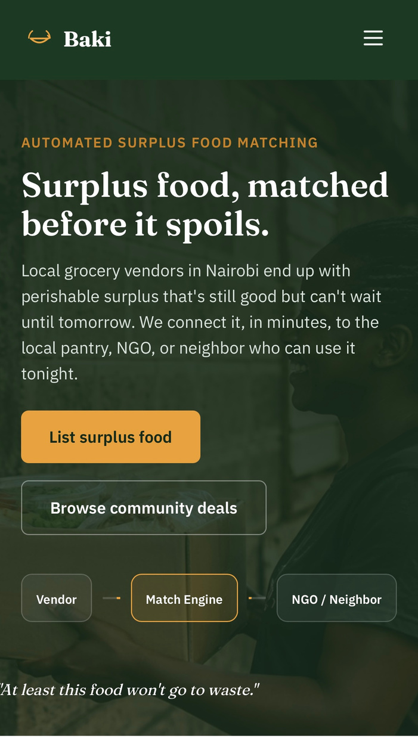
BAKI
AUGUST 14TH, 2026
Surplus food, matched before it spoils.
Every day, perfectly usable food can become waste simply because there’s no fast way to connect it with someone who needs it. Baki was created to address that gap.
Catalyst Alliance
SDG 2 — Zero Hunger

Slide 2
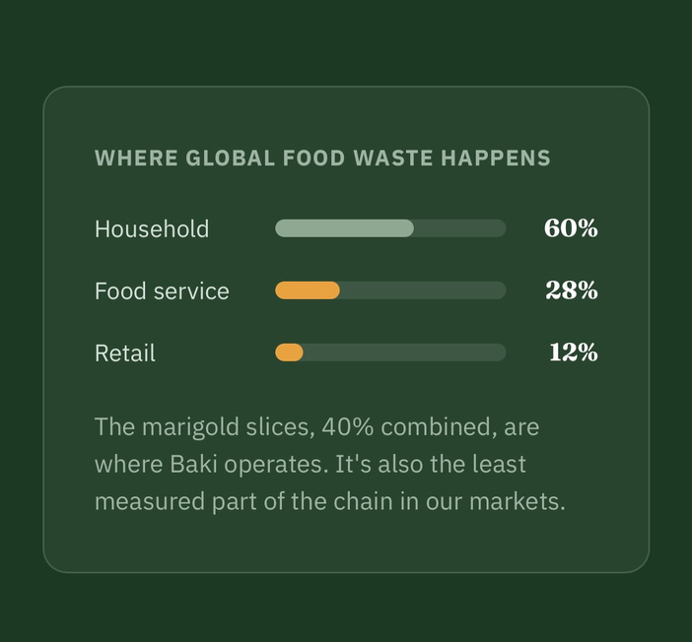
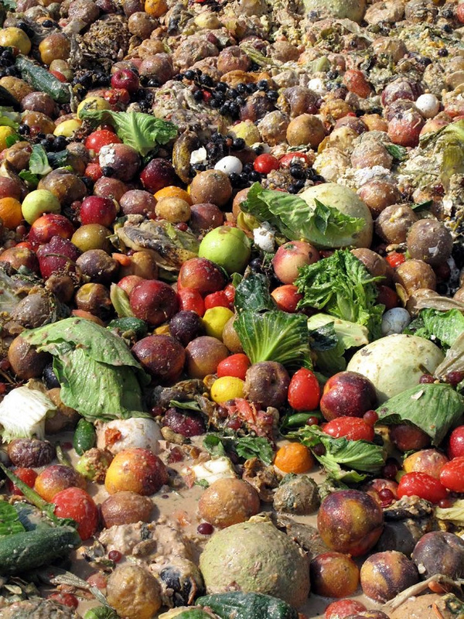
GOOD FOOD IS BEING WASTED WHILE PEOPLE STILL NEED FOOD.
🏪 SURPLUS
Retailers have food they can no longer sell.
🔗 DISCONNECTION
Potential recipients may not know the food is available.
The problem we identified isn’t simply food waste. It’s a coordination problem. Vendors may have surplus food, while NGOs, food banks and communities nearby may need it, but there isn’t always an efficient way to connect the two before that food spoils.
⏱️ TIME
Perishable food has a limited window for redistribution.

Slide 3
WHY THIS MATTERS
306M
Africans were undernourished in 2024
OUR SOLUTION SUPPORTS
🟢 SDG 2
ZERO HUNGER:
Improve access to food and contribute to ending hunger and food insecurity.
1.05B tonnes
of food was wasted globally in 2022
🔵 SDG 12.3
RESPONSIBLE CONSUMPTION & PRODUCTION:
Help reduce food waste at the retail and consumer levels.
892.7M
Africans faced moderate or severe food insecurity
🌍 SDG 13
CLIMATE ACTION
Reducing food waste also reduces the environmental impact associated with wasted food.
Sources: FAO, Africa Regional Overview of Food Security and Nutrition 2025; UNEP, Food Waste Index Report 2024.

Slide 4
OUR KEY INSIGHT
THE PROBLEM ISN’T ALWAYS A LACK OF FOOD.
IT’S A LACK OF CONNECTION.
BEFORE
🏪 Vendor
↓
🥬 Surplus food
↓
❌ No connection
↓
🗑️ Waste
THE OPPORTUNITY
🏪 Vendor
↓
BAKI
↓
🤝 NGO / Pantry / Community
↓
🍽️ Redistribution

Slide 5
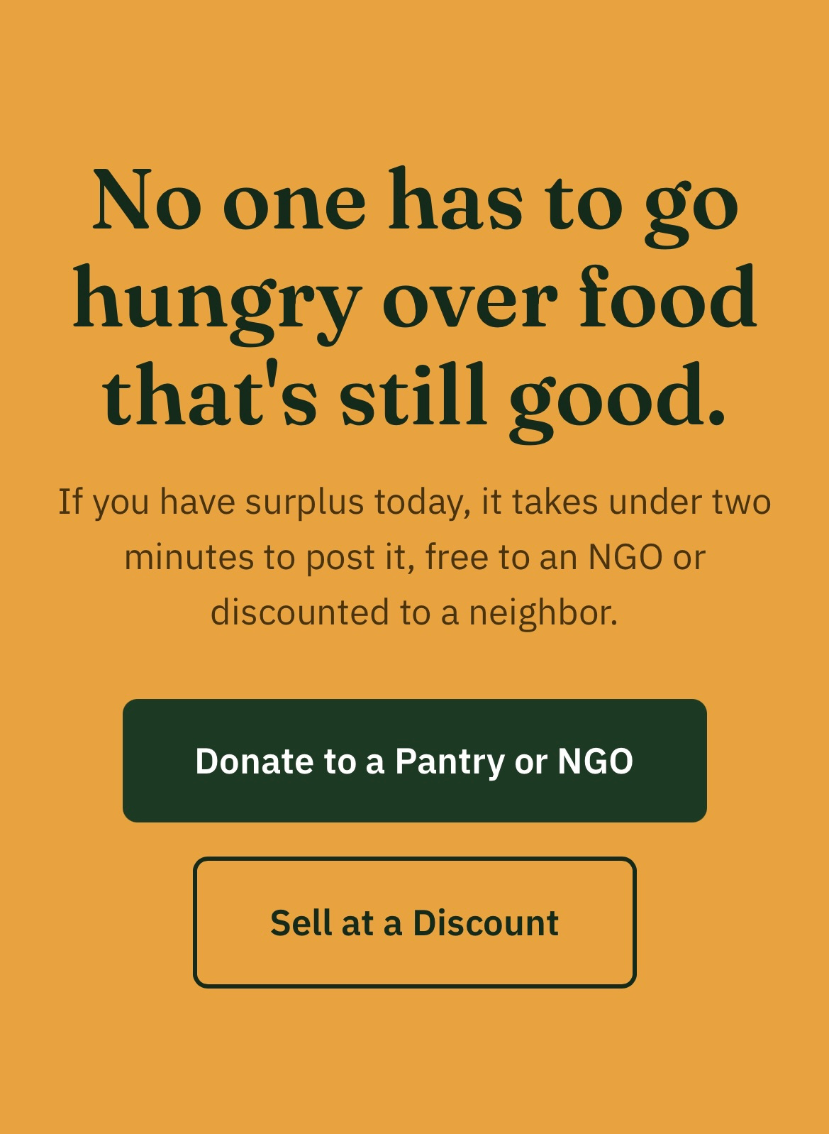
MEET BAKI
A digital coordination platform connecting surplus food with people and organisations that can use it.

Slide 6
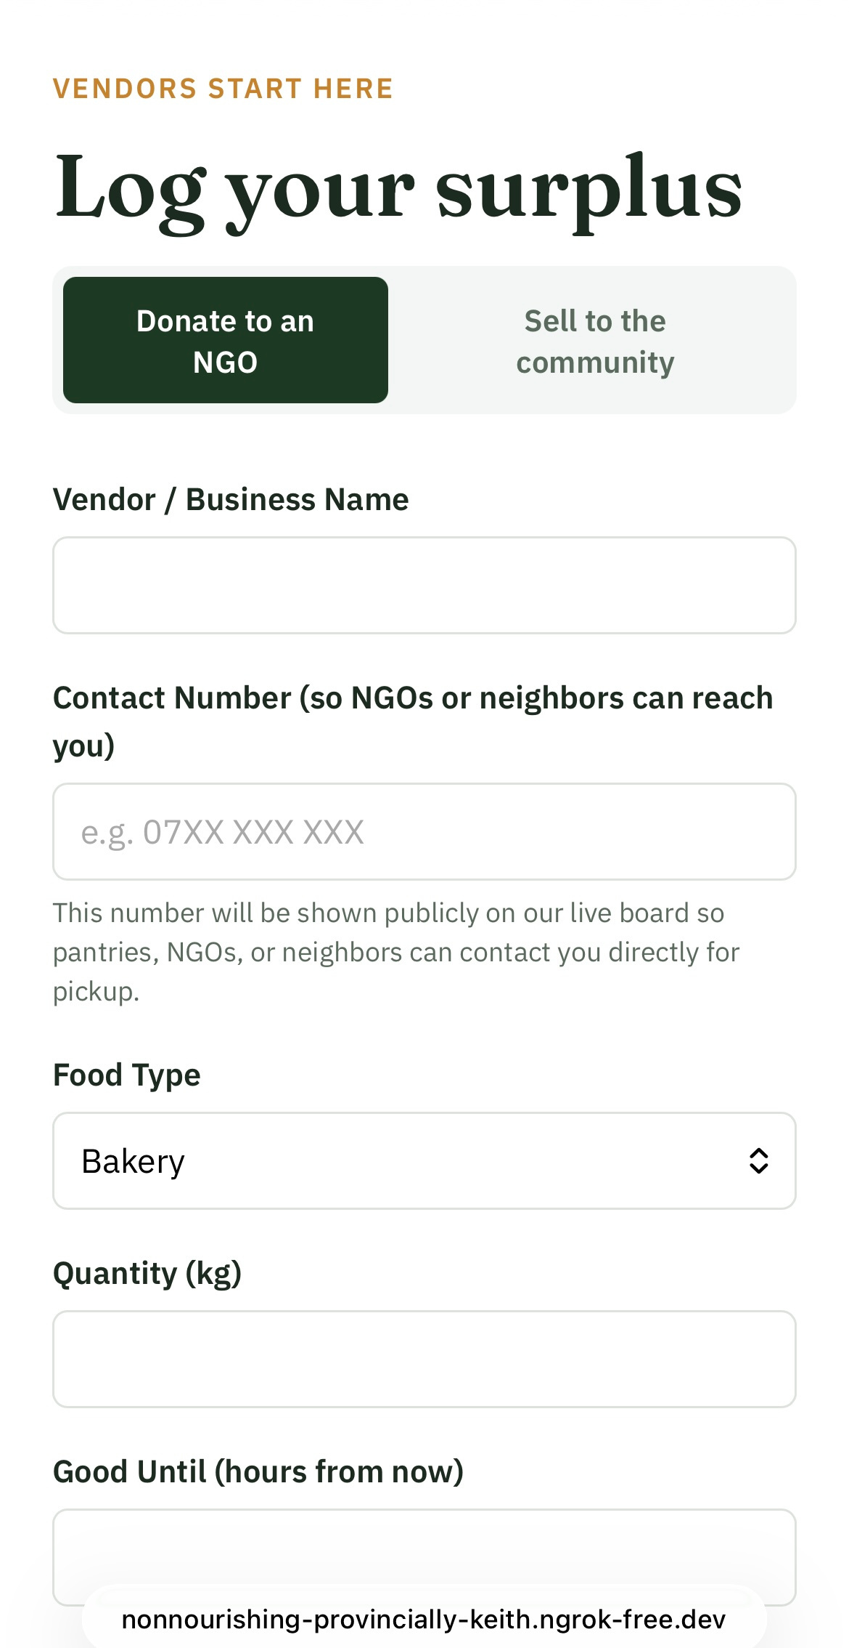
01
LIST
Vendor posts surplus
→
02
MATCH
Suitable recipient identified
→
03
ALERT
Recipient notified
→
04
COLLECT
Pickup coordinated
→
05
REDISTRIBUTE
Food reaches the community
HOW BAKI WORKS
Baki connects food vendors with nearby NGOs, pantries, and community members through a simple, time-sensitive redistribution process. Vendors list their surplus, Baki helps identify a suitable recipient, and the food is then collected and redistributed before it spoils.
Local • Time-sensitive • Coordinated

Slide 7
TWO WAYS TO KEEP FOOD IN CIRCULATION
🍲 DONATE
Vendor
↓
Pantry / NGO
↓
Community
🛒 SELL AFFORDABLY
🏪 Vendor
↓
💰 Affordable listing
↓
👥 Community
For surplus intended for charitable redistribution.
For surplus intended for charitable redistribution.
Different pathways. Same goal: prevent usable food from becoming waste.

Slide 8

THE PEOPLE BEHIND THE NETWORK
🏪 FOOD VENDORS
Need:
A quick way to move surplus.
Baki:
Listing + matching.
👥 COMMUNITY
Need:
Access to free or affordable food.
Baki:
Discover available surplus.
🤝 NGOs / FOOD BANKS
Need:
Reliable access to available surplus.
Baki:
Verification + matching + alerts.
One network. Multiple beneficiaries.

Slide 9
BUILDING THE PRODUCT IS ONLY HALF THE SOLUTION.
AWARENESS
↓
People discover Baki
INTEREST
↓
They understand the value
SIGN-UP
↓
They join the network
FIRST ACTION
↓
They list / donate / claim
SUCCESSFUL MATCH
↓
They see the value
RETENTION
↓
They come back
Our marketing focus:
Turn awareness into adoption.

Slide 10
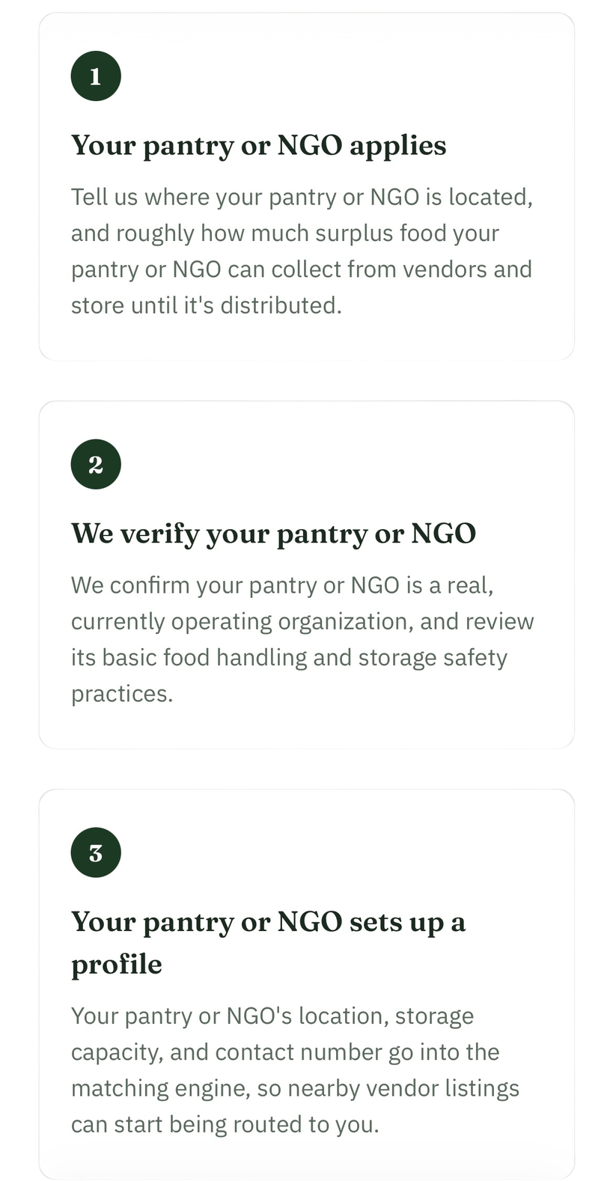
HOW WE’LL MEASURE IMPACT
LISTINGS
How many surplus listings?
MATCHES
How many successful connections?
FOOD REDISTRIBUTED
How many kg diverted from waste?
RETENTION
How many users return?
VALIDATE → PILOT → MEASURE → SCALE
BAKI
Surplus food, matched before it spoils.

